Slide 1
Pulse Width Modulation
Pulse Width Modulation (PWM) is a method of digitally encoding analog signal levels. High-resolution digital counters are used to generate a square wave of a given frequency, and the duty cycle of that square wave is modulated to encode the analog signal.
Typical applications for PWM are switching power supplies, motor control, servo positioning and lighting control.
modulating/varying the width of the pulse only, not the frequency. In the digital control system, PWM is used to control the amount of power sent to a device.
The speed of the motor depends on three factors: (a) load, (b) voltage, and (c) current

Slide 2
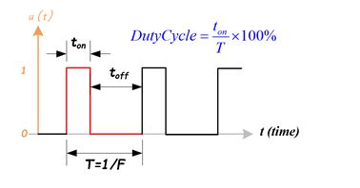
Principal
A PWM signal consists of two main components that define its behavior:
a duty cycle
The duty cycle describes the amount of time the signal is in a high (ON) state as a percentage of the total time it takes to complete one cycle. A lower duty cycle corresponds to lower power, because the power is OFF for most of the time
2. Frequency
The frequency determines how fast the PWM completes a cycle, i.e.. 100Hz would be 100 cycles per second

Slide 3
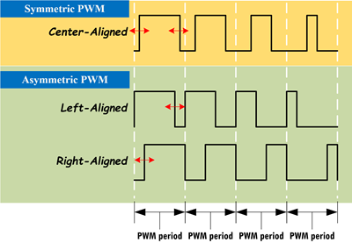
Types of PWM
Symmetric PWM
The pulses of a symmetric PWM signal are always symmetric with respect to the center of each PWM period.
Symmetric PWM are often used for three-phase AC induction and brushless DC motors, due to the lower harmonic distortion that is generated on phase currents in comparison to asymmetric PWM methods.
Asymmetric PWM
The pulses of an asymmetric PWM signal
always have the same side aligned with
one end of each PWM period.
Asymmetric PWM can be used for
stepper motors and other variable-reluctance
motors.

Slide 4
configuration
The TM4C123GH6PM has two PWM modules
Each PWM module consists of:
Four PWM generator blocks
A control block which determines the polarity of the signals and which signals are passed to the pins
Each PWM generator block produces:
Two independent output signals of the same frequency or A pair of complementary signals with dead-band generation(for H-bridge circuit protection )
Eight outputs total

Slide 5
PWM Generator Features
There are two PWM modules, PWM0 and PWM1.
Each PWM module has four Generators.
Each Generator has a Counter (Timer).
Each Generator has two Compare registers CMPA and CMPB.
Each Generator has two output pins, which means there are a total of 8 PWM pins per module.
The Counter of the Generator can be programmed to count-up or count-up/down.
As the Counter counts , it may change the output pin when the counter value matches the:
Compare register(s),
reaches zero, or is
reloaded.
The options for output pin change are:
toggle,
driven HIGH.
driven LOW

Slide 6
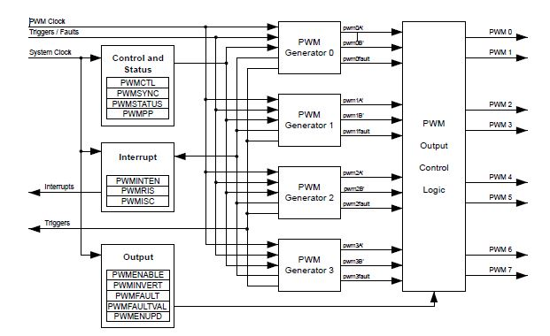
PWM Module Block Diagram

Slide 7
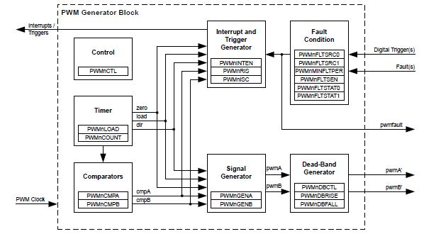
PWM Generator Block Diagram
In the TM4C123GH6PM MCU system, each PWM generator block is composed of two components:
One 16-bit Counter or Timer and
Two PWM Comparators, cmpA and cmpB.
The counter provides a timing base for two comparators, and it is mainly used to perform count-down or count-up/down functions to provide a comparison source for two comparators.

Slide 8
Clock Configuration
The PWM has two clock source options:
■ The System Clock
■ A pre-divided System Clock
The clock source is selected by programming the USPWMDIV bit in the Run-Mode Clock Configuration (RCC) register at System Control offset 0x060.
The PWMDIV bitfield specifies the divisor of the System Clock that is used to create the PWM Clock.

Slide 9
PWM Timer
Count up- Zero to Load
Centre Aligned
Count Down-Load to Zero
Left-Aligned
Right-Aligned
The timers output three signals that are used in the PWM generation process:
the direction signal(this is always Low in Count-Down mode, but alternates between Low and High in Count-Up/Down mode),
a single-clock-cycle-width High pulse when the counter is zero,
a single-clock-cycle-width High pulse when the counter is equal to the load value

Slide 10
PWM Comparator
LOAD is the value in the PWMnLOAD register
COMPA is the value in the PWMnCMPA register
COMPB is the value in the PWMnCMPB register
Signals
0 is the value zero
load is the internal signal that has a single-clock-cycle-width High pulse when the counter is equal to the load value
zero is the internal signal that has a single-clock-cycle-width High pulse when the counter is zero
cmpA is the internal signal that has a single-clock-cycle-width High pulse when the counter is equal to COMPA
cmpB is the internal signal that has a single-clock-cycle-width High pulse when the counter is equal to COMPB
dir is the internal signal that indicates the count direction has a single-clock-cycle-width High pulse when the counter is zero

Slide 11
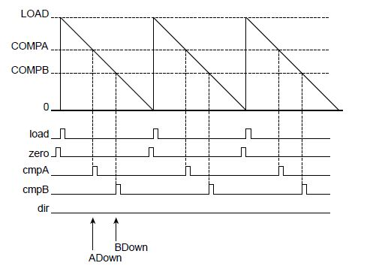
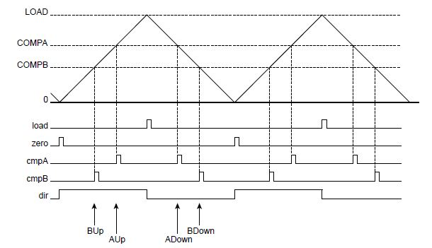
PWM waveforms
PWM Count Down Mode
PWM Count up/down Mode

Slide 12
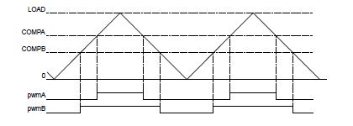
PWM Signal Generator
In Count-Down mode, there are four events that can affect these signals:
zero, load, match A down, and match B down.
In Count-Up/Down mode, there are six events that can affect these signals:
zero, load, match A down, match A up, match B down, and match B up

Slide 13
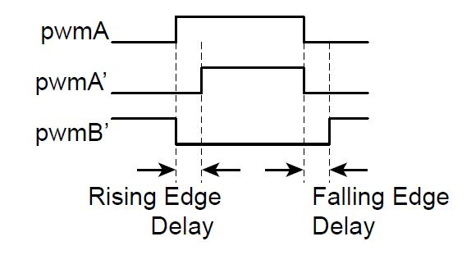
Dead Band Generator
pair of active High signals where one is always High, except for a programmable amount of time at transitions where both are Low. These signals are therefore suitable for driving a half-H bridge, with the dead-band delays preventing shoot-through current from damaging
the power electronics

Slide 14
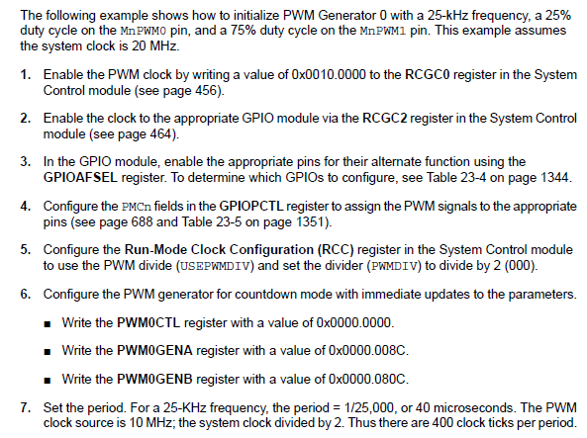
Initialization

Slide 15
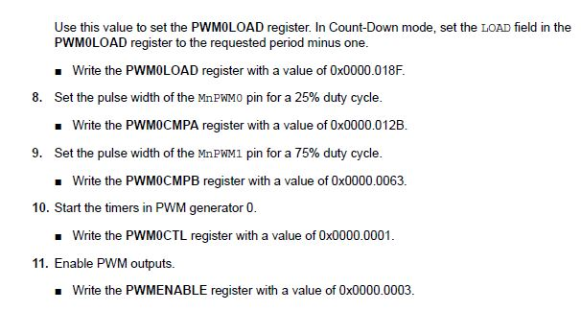
Initialization

Slide 16
Aim: To control the brightness of on board LED Using PWM
Port F PIN2-Blue
Port F PIN3-Green
Module=PWM1
Configuration=M1PWM7,M1PWM6
Generator=Module 1 PWM Generator-3
Base Freq=100Hz

Slide 17
Steps to configure PWM module:
Set PWM clock
Enable PWM module
Enable GPIO module (so that GPIO can be configured to PWM out)
Set GPIO pins to PWM out
Configure PWM pin modules
Configure PWM generator (count up/count down/ count up-down)
Set the PWM base frequency
Set the PWM pulse width
Enable output on PWM pins
Enable PWM generator and set to run mode

